Slide 1
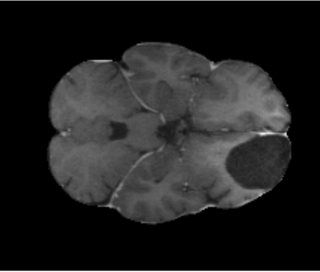
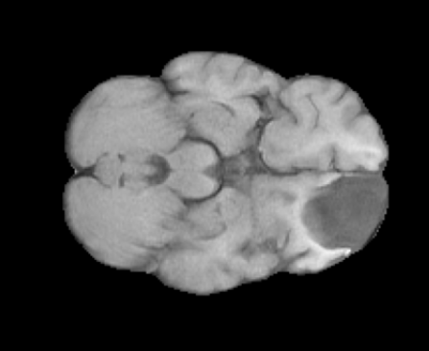
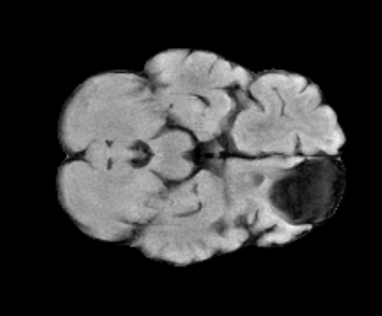
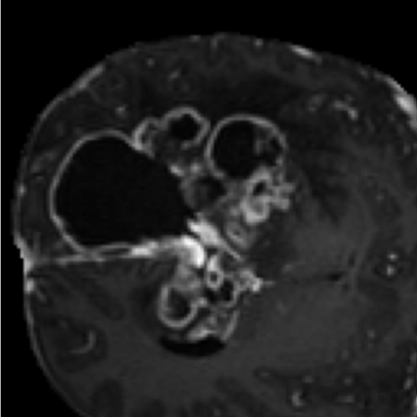
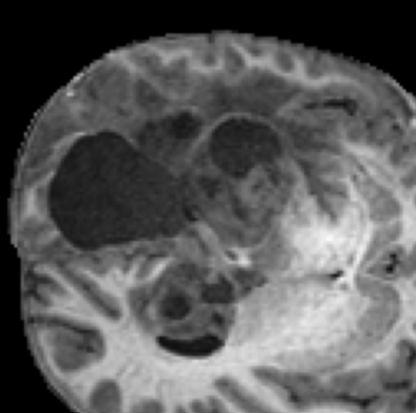
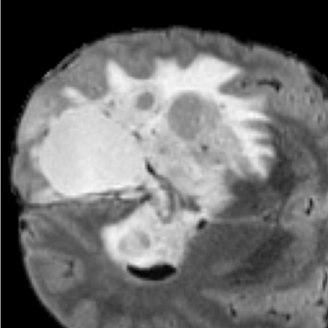
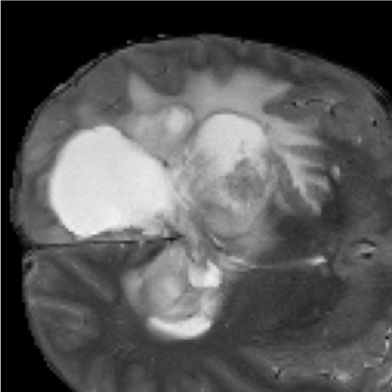
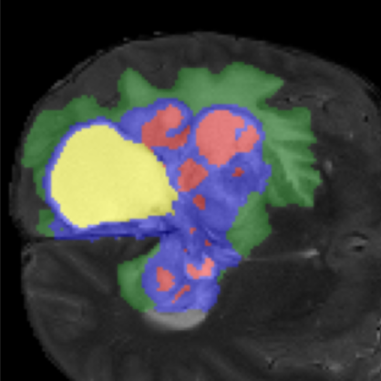
Multi-Parametric MRI (Full 3D Volumes)
Encoder
Multi-Scale Gated ABMIL
FiLM Bottleneck Conditioning
Bottleneck 256 channels
T1c
T1n
T2f
T2w
Global Pooling
Global Polling of E1-E4
Gated Attention Weighting
Context Vector z
Input Volume
Input Volume
Input Volume
E1
Conv3D + IN + GELU
γ(z), β(z)
β' = γ ⊙B + β'
Input Volume
(16)
“Channels” refers to the number of feature channels (feature maps).
Conv3D + IN + GELU
Global Pooling
E2
(32)
E1
Conv3D + IN + GELU
Global Pooling
E2
X
1 x 1 x 1 Conv + SoftMax
Un-Supervised Tumor-Centered Patch Extraction
E3
z
Preserve complete tumor context
(64)
E3
E4
Conv3D + IN + GELU
Global Pooling
E4
5 - Class Glioma Segmentation
Tumor-Centered 3D Volumes
(128)
Non-Enhancing Tumor Core (NETC)
T1c
T1n
T2f
T2w
Decoder Level 4
Attention Gate
Attention Gate (E4, z)
Concatenation + Upsample
Input Volume
Input Volume
Input Volume
Input Volume
Enhancing Tissue (ET)
Decoder Level 3
Surrounding Non-Flair Hyperintensity (SNFH)
Attention Gate
Attention Gate (E3, z)
Concatenation + Upsample
Tumor-Centered 3D Volumes (All Modalities)
Resection Cavity (RC)
Input Patch (128 x 128 x 128 x 4)
Attention Gate
Decoder Level 2
Attention Gate (E2, z)
Concatenation + Upsample
Decoder Level 1
Attention Gate
Attention Gate (E1, z)
Concatenation + Upsample

